Slide 1
Development of educational resources oriented to the Maker culture for the conceptual design course.
Diego Alejandro Zorrilla.
Juan Camilo López.
Sergio Alejandro Bolaños.
Group: IGA3

Slide 2

Maker
Describe those people who can generate new knowledge, activities or products by themselves.
New technologies have a very important role in this culture.

Slide 3
Identification and classification of the design attributes.
Juan Camilo López

Slide 4


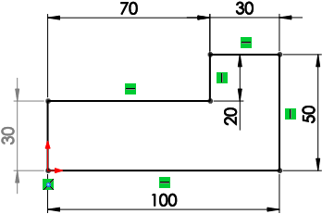

Design attributes
1. Objectives: are the things that the designer wants to achieve.
3. Functions: these ones represent every activity that the object must do.
2. Restrictions: are the limitations and the aspects that the object must respect.
4. Implementations: represent the ways to execute the functions of the product.

Slide 5
Activity
Do a reverse engineering.
Analyze all the parts that make up the system.
We will use LittleBits for doing the activity.
Identify each design attribute and classify them into categories.

Slide 6
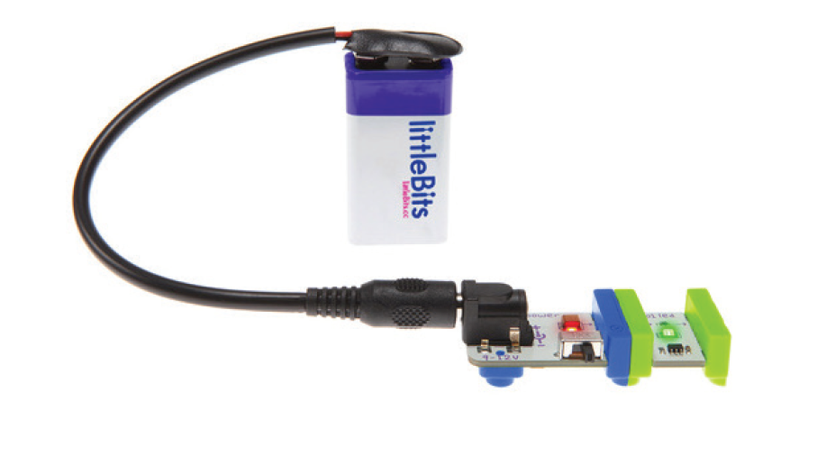
LittleBits
Are a modular electronic system that can be connected with other bits thanks to the magnets at the end.
There are a lot of types of LittleBits, each one has a unique function.
Power (Blue): generates electricity.
Input (Pink): makes possible the control of the circuit.
Output (Green): does an action.
Wire (Orange): increases the size, changes the direction or adds complexity and programmability to the circuit.

Slide 7
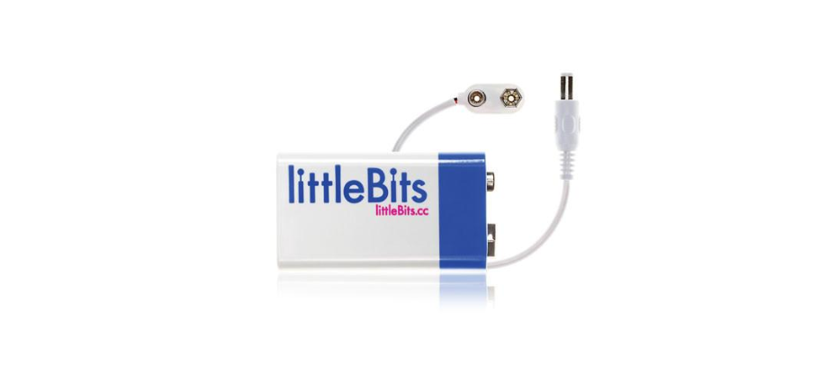
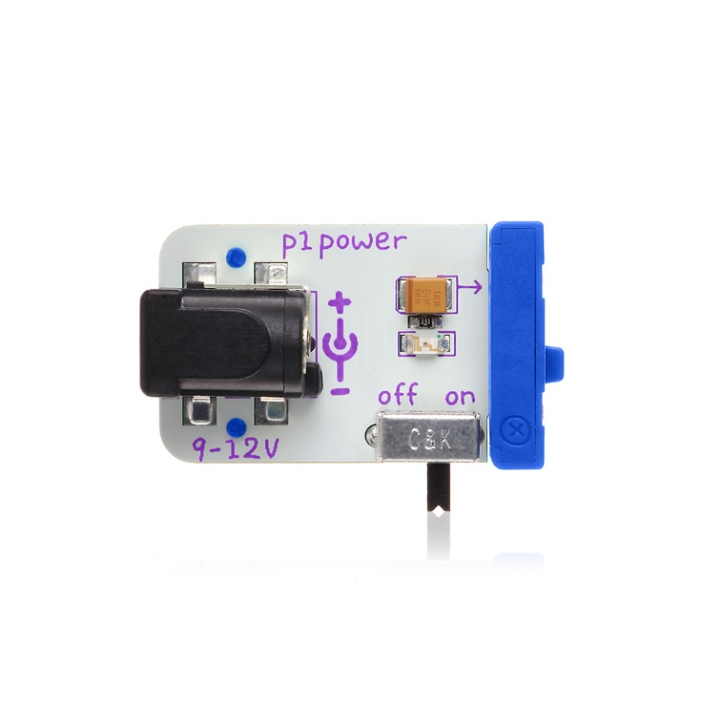
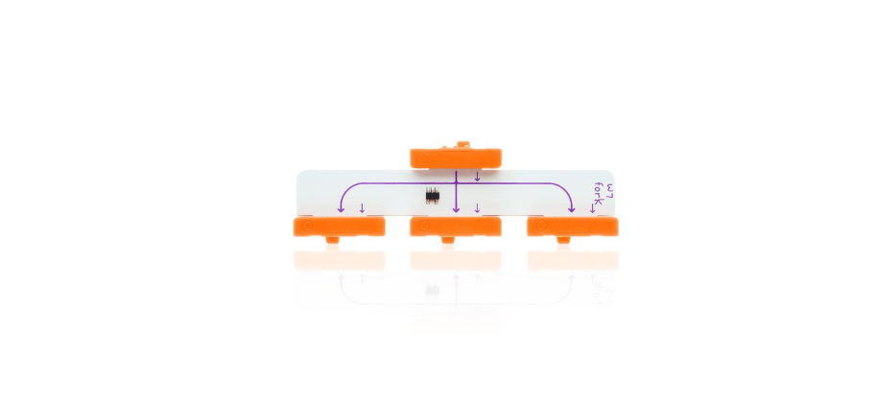
LittleBits used in the activity.

Slide 8
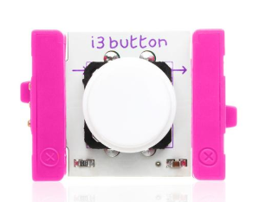
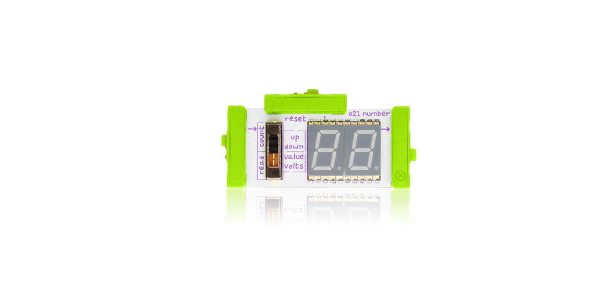
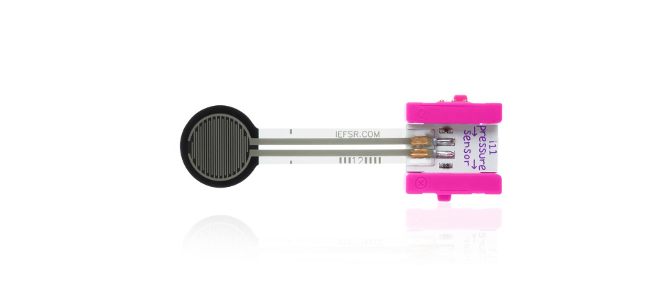
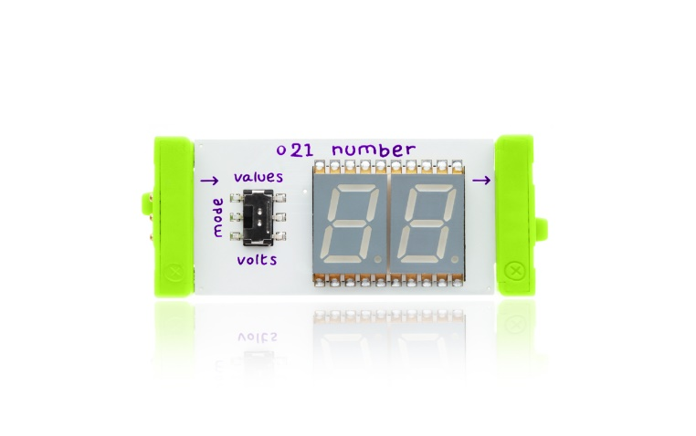
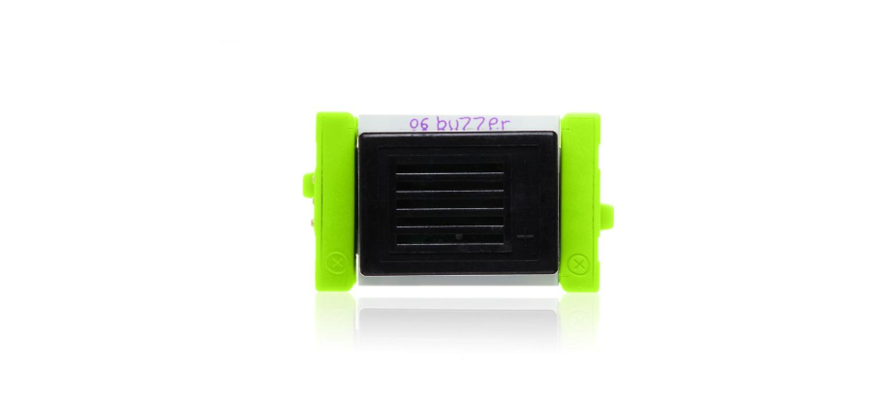
LittleBits used in the activity.

Slide 9
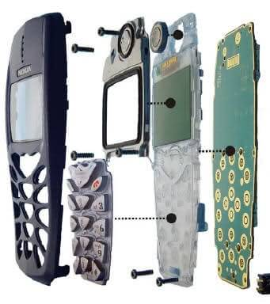
Instructions
Form groups of four people.
Each group will have a folder on disk with all the information.
With the help of someone, we will disarm the circuit and each group will analyze the disassembled part.
Analyze the design concept and the application to identify the other attributes.

Slide 10
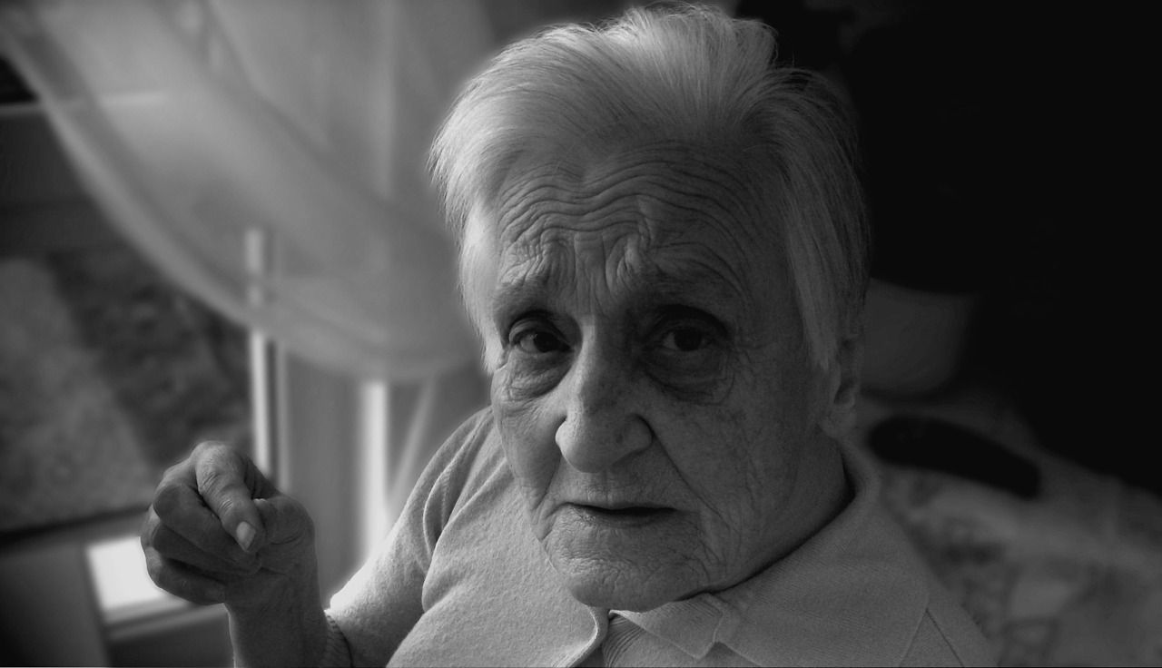
Problem
The danger in the care of patients with senile dementia.
It is a serious deterioration of mental capacity that interferes with daily life.
An example are memory problems.
Alzheimer's disease is the most common type of dementia.

Slide 11
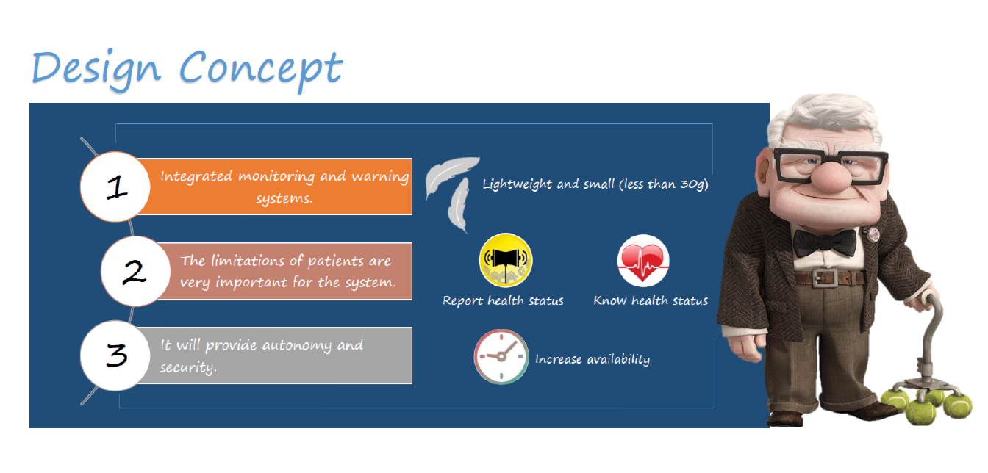

Slide 12
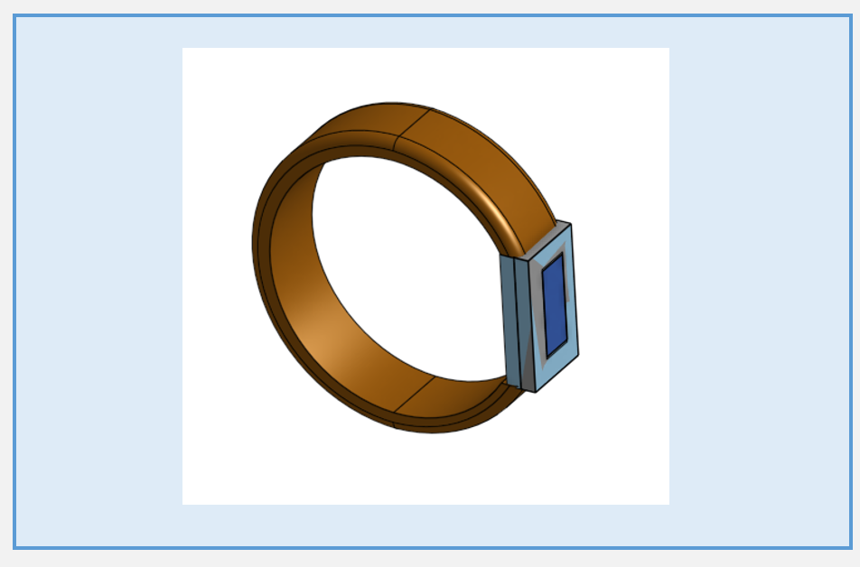
Product
3D prototype.

Slide 13
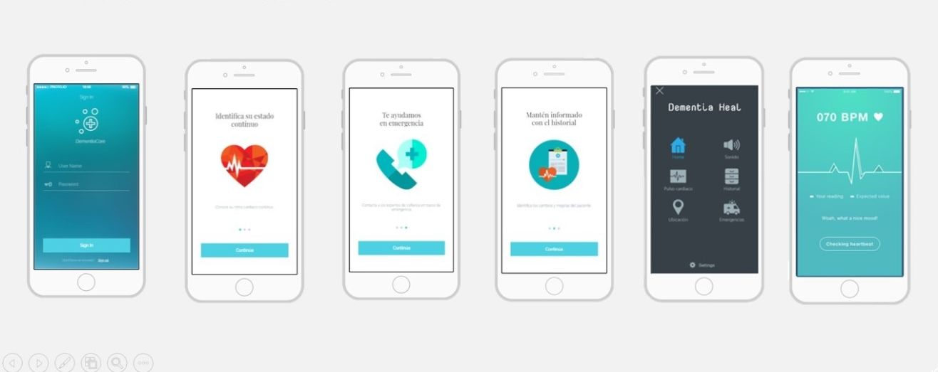
Monitoring app

Slide 14
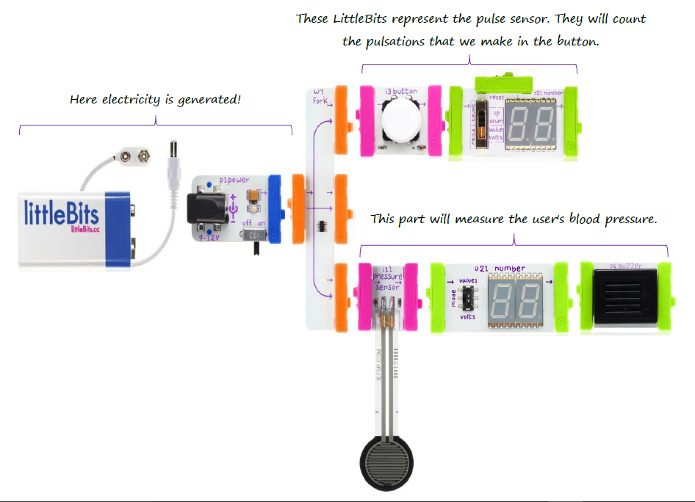
Representation of the product with LittleBits.

Slide 15
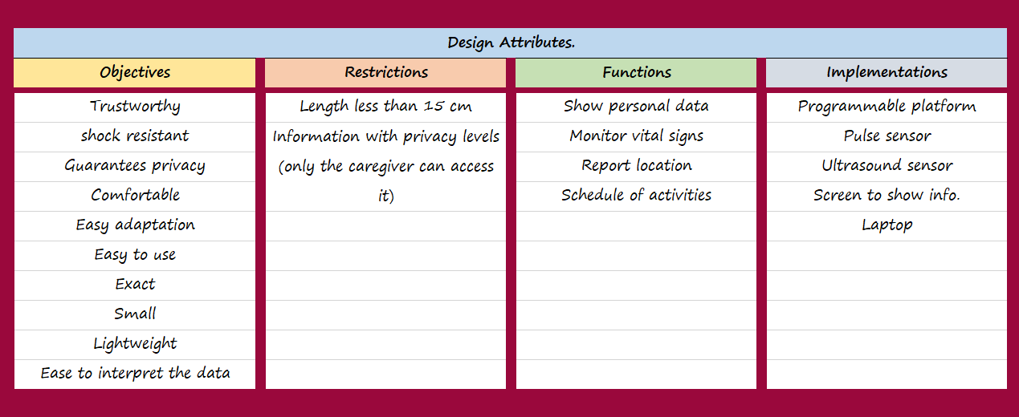

Slide 16
AHP
The Analytic Hierarchy Process (AHP), is an effective tool for dealing with complex decision making, and may aid the decision maker to set priorities and make the best decision.
How the AHP works ?
The AHP considers a set of evaluation criteria, and a set of alternative options among which the best decision is to be made.

Slide 17
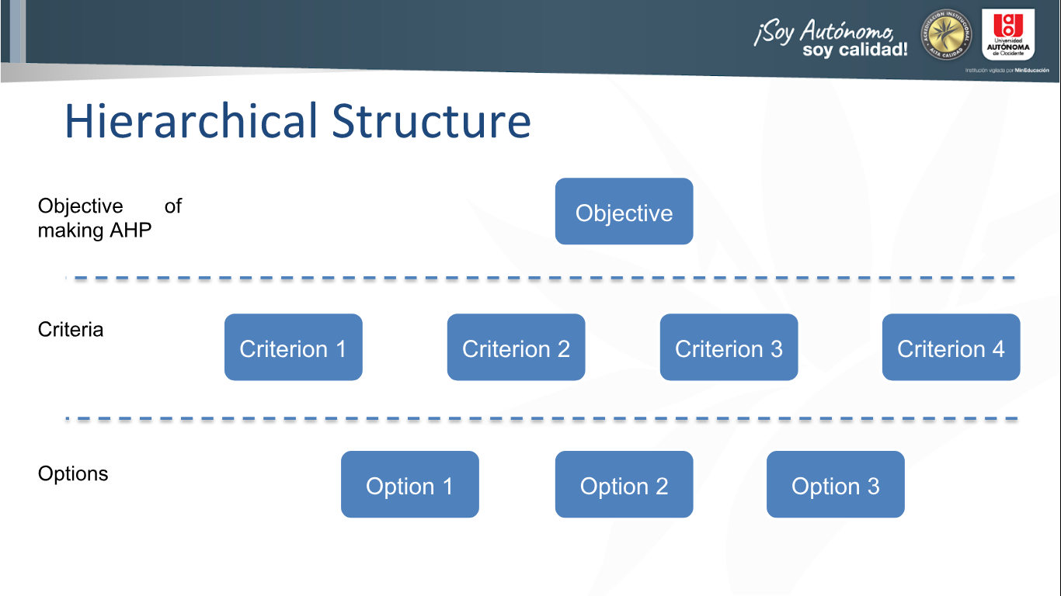

Slide 18
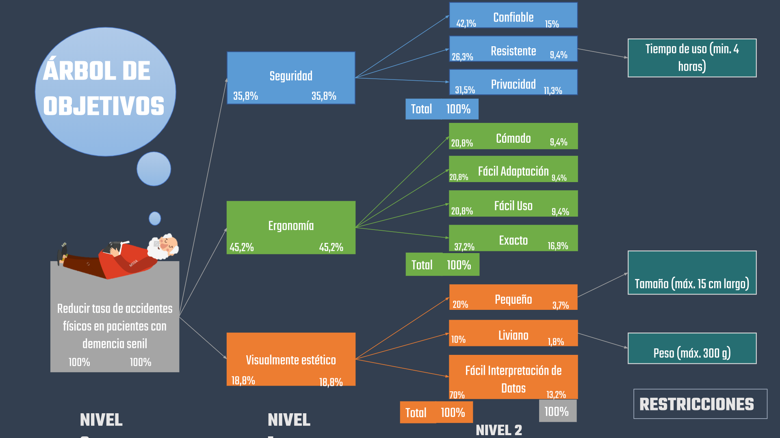

Slide 19
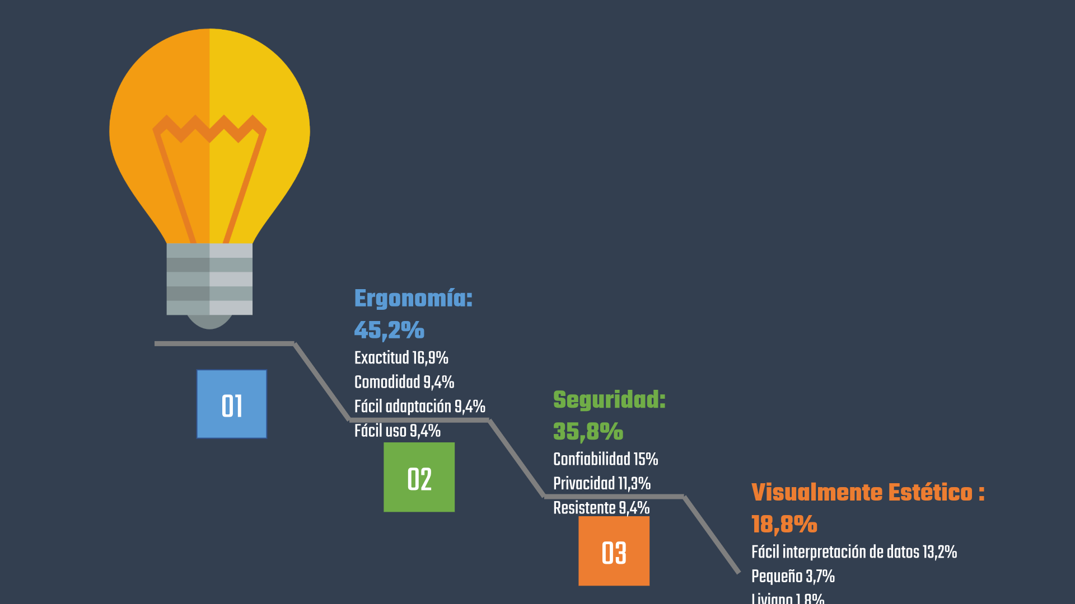

Slide 20
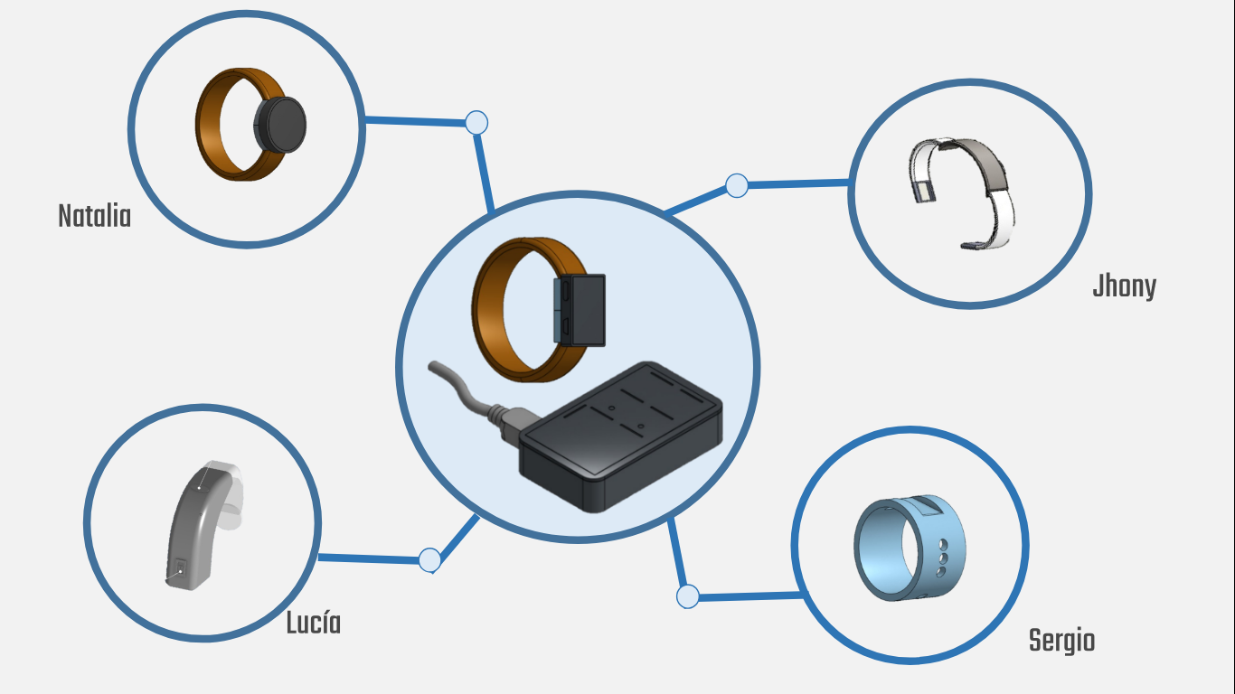

Slide 21
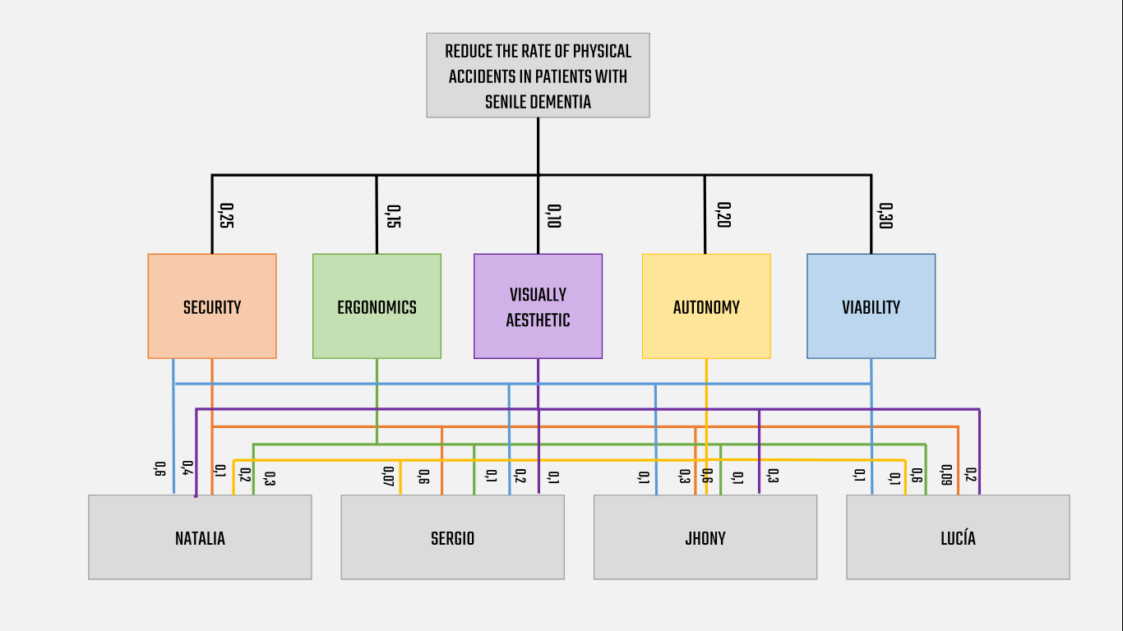

Slide 22
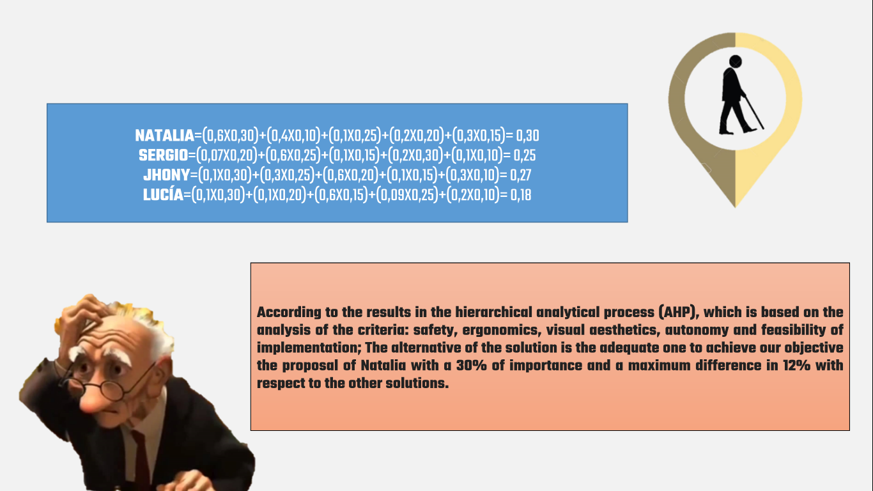

Slide 23
Thank you!

